Slide 1
Software Engineering I
Dr. Elham Mahmoudzadeh
Isfahan University of Technology
mahmoudzadeh@iut.ac.ir
2024

Slide 2
Agile

Slide 3
Agile vs Traditional development process
The goal of comparing agile principles with traditional development principles is not to make the case that plan-driven, sequential development is bad and that agile is good.
Both are tools in the professional developer’s toolkit; there is no such thing as a bad tool, rather just inappropriate times to use that tool.
Scrum and traditional development process are appropriate to use on different classes of problems.

Slide 4
Plan-driven process(I)
The idea here is that the better the planning, the better the understanding, and therefore the better the execution.
Works well if you are applying it to problems that are well defined, predictable, and unlikely to undergo any significant change.
The problem is that most product development efforts are anything but predictable, especially at the beginning.
After all, developing a product rarely goes as planned.

Slide 5
Plan-driven process(II)
There is a belief that it should work. If applying a plan-driven approach doesn’t work, the prevailing attitude is that we must have done something wrong. Sure that if they just do it better, their results will improve. The problem, however, is not with the execution.
It’s that plan-driven approaches are based on a set of beliefs that do not match the uncertainty inherent in most product development efforts.

Slide 6
Traditional Software development
It typically begins with a detailed planning phase.
The team arrives at an estimate of how long the development will take by adding up detailed estimates of the individual steps involved.
Once stakeholders have thoroughly reviewed the plan and provided their approvals, the team starts to work.
Once the work is complete, it is delivered to a testing organization, which completes testing prior to the product reaching the customer. Throughout the process, strict controls are placed on deviations from the plan to ensure that what is produced is actually what was designed.

Slide 7
Traditional software development Pros.
It is supremely logical.
Think before you build.
Write it all down.
Follow a plan.
Keep everything as organized as possible.

Slide 8
What’s Wrong With Traditional Software Development?
Humans are involved.
Creativity is inhibited.
Written documents have their limitations.
Bad timing.
No crystal balls.
Too much work and no fun.
Sub-optimized results.

Slide 9
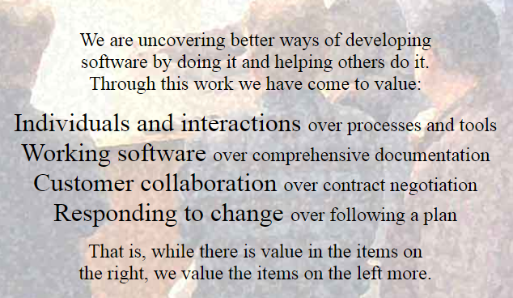
Manifesto for Agile Software Development

Slide 10
Principles Behind the Agile Manifesto(I)
Our highest priority is to satisfy the customer through early and continuous delivery of valuable software.
Welcome changing requirements, even late in development. Agile processes harness change for the customer’s competitive advantage.
Deliver working software frequently, from a couple of weeks to a couple of months, with a preference to the shorter timescale.
Business people and developers must work together daily throughout the project.

Slide 11
Principles Behind the Agile Manifesto(II)
Build projects around motivated individuals. Give them the environment and support they need, and trust them to get the job done.
The most efficient and effective method of conveying information to and within a development team is face-to-face.
Working software is the primary measure of progress.
Agile processes promote sustainable development. The sponsors, developers, and users should be able to maintain a constant pace indefinitely.

Slide 12
Principles Behind the Agile Manifesto(III)
Continuous attention to technical excellence and good design enhances agility.
Simplicity–the art of maximizing the amount of work not done–is essential.
The best architectures, requirements, and designs emerge from self-organizing teams.
At regular intervals, the team reflects on how to become more effective, then tunes and adjusts its behavior accordingly.

Slide 13
Reference
1- K. S. Rubin, “Essential Scrum, A Practical guide to the most popular agile process,” 2013.
2- J. Sutherland, “Scrum handbook,” 2010.

Slide 14
What we will talk about next…
Scrum

